Slide 1

Data Warehousing and Decision Support Systems
Seven Topics: DSS, OLTP vs OLAP, Data Warehouse, OLAP Cubes, Dimensional Modeling, Query Processing and BI, KNIME

Slide 2
Topic 1
Decision Support Systems (DSS)

Slide 3
Introduction
Decision Support Systems (DSS)
Definition: an interactive, computer-based system that helps managers use data and models to solve semi-structured and unstructured problems
Need: data overload, complex and fast-changing business conditions, demand for evidence-based decisions
Importance: faster, more consistent and better-informed decisions
A DSS supports the decision maker; it does not replace human judgement

Slide 4
Core Concepts
Decision Support Systems (DSS)
Data component: internal, external and warehouse data
Model component: statistical, optimization and what-if models
UI component: dashboards, queries, reports for the user
Types: data-driven, model-driven, knowledge-driven, document-driven, communication-driven
Decision Maker
User Interface (UI)
Model Management (Model Base)
Data Management (Database / DW)

Slide 5
Process / Architecture
How a DSS Supports a Decision
1
Define the problem
Decision maker states the goal and constraints
2
Collect data
Pull relevant data from databases and the warehouse
3
Select a model
Forecast, optimization or simulation model
4
Run what-if analysis
Test alternatives and scenarios
5
Present and decide
Results shown on dashboards; manager decides

Slide 6
Real-World Example
Real-World Applications
Banking: credit scoring and loan approval, fraud detection, portfolio risk analysis
Healthcare: clinical DSS for diagnosis support, drug-interaction alerts, treatment planning
Hospitals also use DSS for bed allocation and resource planning
Banks combine customer history + scoring models to recommend approve / reject

Slide 7
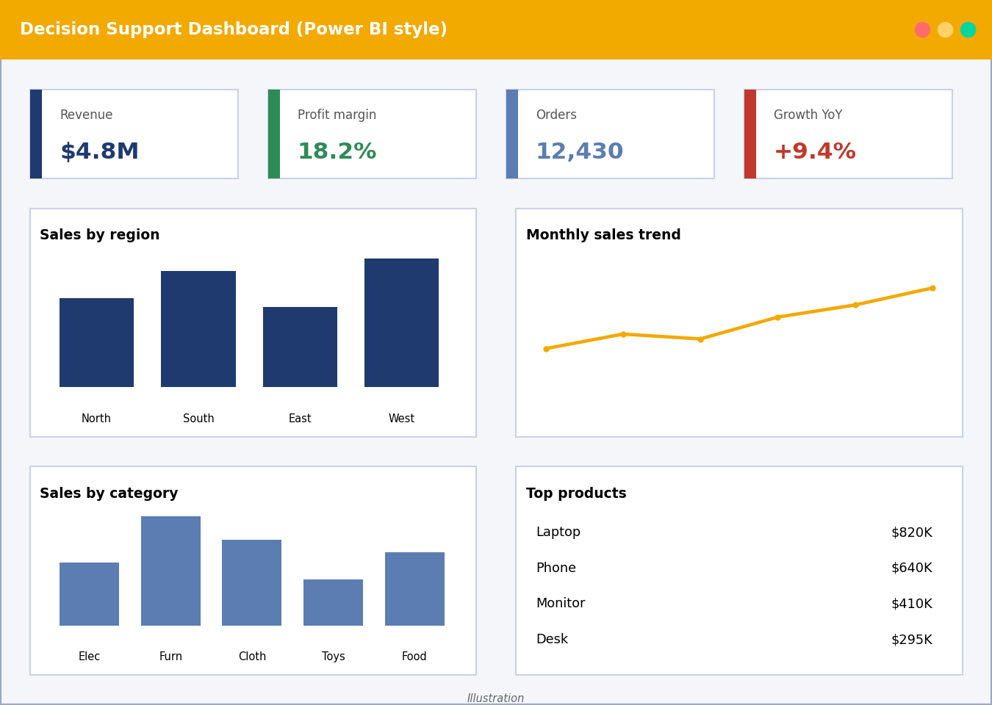
Tool / Demo
Tools Used to Build a DSS
Spreadsheets with Solver / what-if tables
BI platforms: Power BI, Tableau, Apache Superset
Analytics workflows: KNIME, Python, R
Database / data warehouse as the data layer
Illustration: DSS dashboard in the style of Power BI

Slide 8
Conclusion
Summary and Future Scope
Summary
Advantages: faster decisions, better accuracy, scenario testing, consistent analysis
Limitations: costly to build, depends on data quality, needs user training, cannot capture every human factor
Future Scope
AI/ML-powered and real-time DSS
Cloud-based and mobile DSS; natural-language interfaces

Slide 9
Topic 2
Operational Systems vs DSS

Slide 10
Introduction
Operational Systems vs DSS
Operational systems (OLTP) record day-to-day business transactions: orders, payments, bookings
DSS / data warehouse systems (OLAP) analyse historical data to support decisions
The two have different goals, so they are kept on separate systems
Understanding the difference guides correct system design

Slide 11
Core Concepts
Operational Systems vs DSS
OLTP: many short read/write transactions, current data
OLAP: fewer, complex, read-heavy queries over history
Aspect | OLTP (Operational) | OLAP / DSS
Data | Current, detailed, normalized | Historical, summarized, denormalized
Users | Clerks, cashiers, customers | Managers, analysts, executives
Purpose | Run the business | Analyse and plan the business
Operations | Insert / update / delete | Complex reads, aggregation
Size | MBs to GBs | GBs to TBs

Slide 12
Process / Architecture
Integration Between the Systems
1
Operational sources
OLTP databases, files, external feeds
2
Extract
Copy changed data on a schedule
3
Transform
Clean, standardize and integrate
4
Load into warehouse
Store historical data in the DW
5
Analyse
OLAP and BI tools read from the warehouse

Slide 13
Real-World Example
Use-Case Scenarios
Bank: ATM withdrawal and balance update (OLTP)
Bank: analysing monthly spending by branch and region (OLAP)
Retail: POS billing each sale (OLTP) vs seasonal sales trend analysis (OLAP)
Separating the systems keeps analytics from slowing down transactions

Slide 14
Tool / Demo
Performance Comparison
OLTP: millisecond response, thousands of concurrent users, indexes tuned for writes
OLAP: seconds to minutes per query, few users, scans large volumes
OLTP measure: transactions per second
OLAP measure: query response time and throughput

Slide 15
Conclusion
Summary and Future Scope
Summary
OLTP runs the business; OLAP guides it
Operational data feeds the warehouse through ETL
Future Scope
Real-time / HTAP systems blending both
Cloud warehouses with streaming ingestion

Slide 16
Topic 3
Architecture of a Data Warehouse

Slide 17
Introduction
Architecture of a Data Warehouse
Data warehouse: a subject-oriented, integrated, time-variant, non-volatile collection of data for decision making (Inmon)
Stores consolidated history from many source systems
Provides a single version of the truth
Foundation for OLAP, reporting and data mining

Slide 18
Core Concepts
Architecture of a Data Warehouse
Bottom tier: warehouse database + ETL
Middle tier: OLAP server (ROLAP / MOLAP)
Top tier: query, reporting and analysis tools
Data marts: subject-specific subsets (e.g., sales); metadata: data about data
Top: Front-end tools (BI, reports)
Middle: OLAP Server
Bottom: Data Warehouse + Data Marts
Sources: ERP, CRM, files + ETL

Slide 19
Process / Architecture
The ETL Process
1
Extract
Read data from source systems
2
Clean
Remove duplicates, fix errors and nulls
3
Transform
Convert formats, apply business rules, aggregate
4
Load
Write to the warehouse (full or incremental)
5
Refresh and log
Schedule loads; record lineage in metadata

Slide 20
Real-World Example
Case Study: Retail Chain
Stores, e-commerce and suppliers feed separate databases
ETL consolidates them nightly into one warehouse
Data marts for sales, inventory and marketing
Result: unified reports on product performance and stock planning

Slide 21
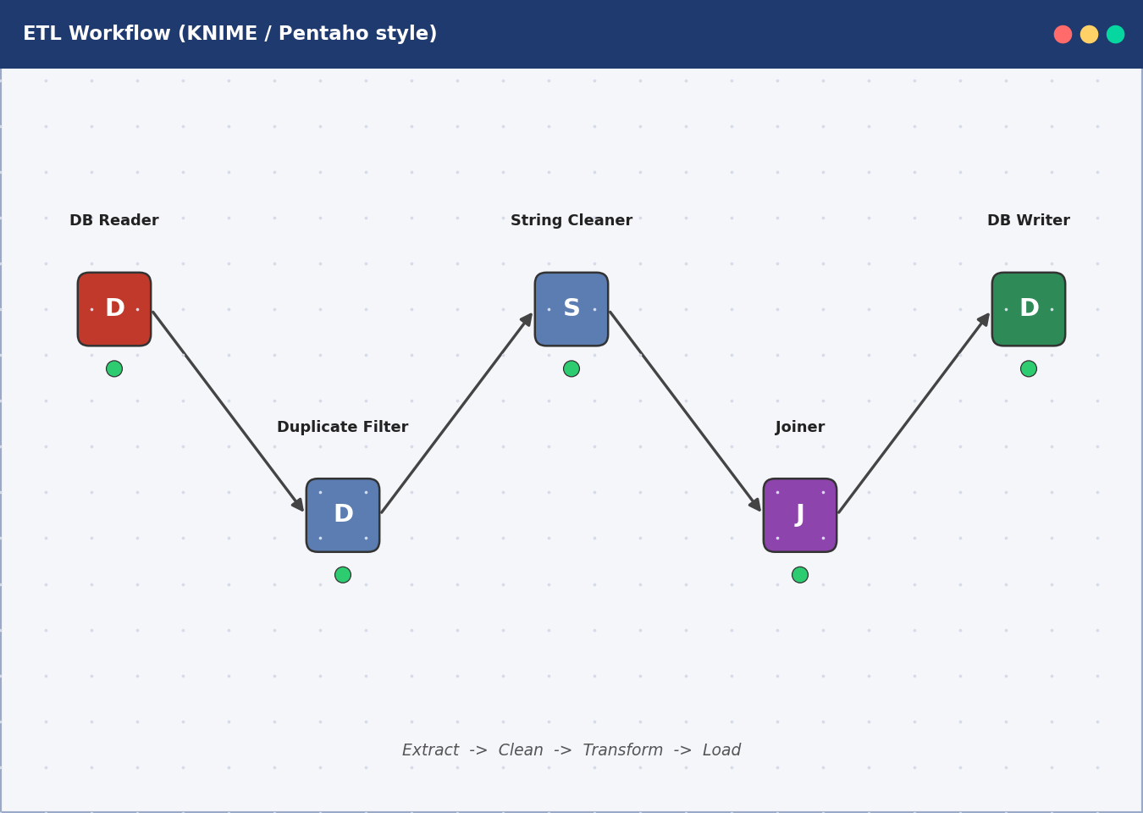
Tool / Demo
Warehouse and ETL Tools
ETL: Talend, Pentaho Data Integration, Apache Hop, KNIME
Warehouses: PostgreSQL, Snowflake, Amazon Redshift, Google BigQuery
Metadata catalogs document tables, columns and lineage
Scheduling: Apache Airflow, cron
Illustration: ETL workflow in the style of KNIME / Pentaho

Slide 22
Conclusion
Summary and Future Scope
Summary
Benefits: consistent data, fast analysis, historical view, better decisions
Three tiers separate storage, processing and presentation
Future Scope
Cloud and lakehouse architectures
Real-time ETL / ELT and automated data quality

Slide 23
Topic 4
OLAP and Data Cubes

Slide 24
Introduction
OLAP and Data Cubes
OLAP (Online Analytical Processing): fast, interactive multidimensional analysis of data
Lets users view measures (sales) by dimensions (time, product, region)
Importance: quick answers to business questions without writing complex queries
Typical users: analysts and managers

Slide 25
Core Concepts
OLAP and Data Cubes
Data cube: measures (facts) arranged along dimensions
Example cube: Sales by Product x Time x Location
Each dimension has concept hierarchies (day > month > quarter > year)
Operation | Meaning | Example
Roll-up | Aggregate to a higher level | Quarter to Year
Drill-down | Move to finer detail | Year to Month
Slice | Fix one dimension value | Year = 2025
Dice | Select a sub-cube on several dimensions | 2025, East, Laptops
Pivot | Rotate the view | Swap rows and columns

Slide 26
Process / Architecture
Applying OLAP Operations Step by Step
1
Start with the cube
Sales (Product, Time, Location)
2
Roll-up
Sum monthly sales to quarterly totals
3
Drill-down
Open a weak quarter to see months
4
Slice and dice
Filter to one year, region and product group
5
Pivot
Rotate to compare regions by product

Slide 27
Real-World Example
Applications in Analytics
Retail: sales trend and product-mix analysis
Banking: profitability by branch, product and period
Healthcare: admissions by department and season
Budgeting, forecasting and KPI tracking

Slide 28
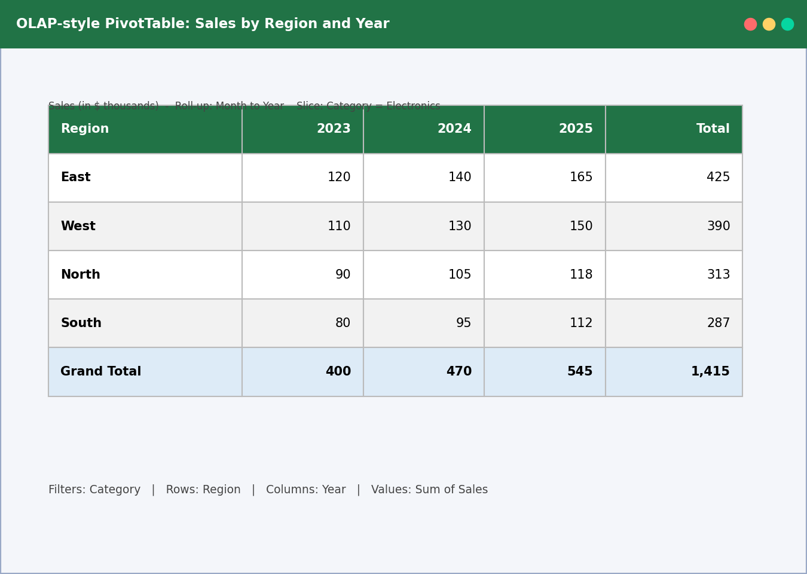
Tool / Demo
OLAP Tools
Types: ROLAP, MOLAP, HOLAP
Microsoft SSAS, Apache Kylin, Mondrian (Pentaho)
Excel PivotTables for simple cube-style analysis
KNIME workflows can mimic OLAP operations
Illustration: Excel PivotTable showing roll-up and slice

Slide 29
Conclusion
Summary and Future Scope
Summary
OLAP turns warehouse data into multidimensional views
Five key operations: roll-up, drill-down, slice, dice, pivot
Future Scope
In-memory and cloud OLAP
AI-assisted insights and natural-language querying

Slide 30
Topic 5
Dimensional Data Modeling

Slide 31
Introduction
Dimensional Data Modeling
Dimensional modeling organizes warehouse data for easy, fast analysis (Kimball approach)
Fact tables hold numeric measures; dimension tables hold descriptive context
Importance: simple for business users and efficient for queries
Two main designs: star schema and snowflake schema

Slide 32
Core Concepts
Dimensional Data Modeling
Fact table: measures + foreign keys (e.g., amount, quantity)
Dimension table: descriptive attributes (customer, product, date)
Grain: what one fact row represents
Star: denormalized dimensions around one fact
Dim_Date
Dim_Customer
Fact_Sales
Dim_Store
Dim_Product

Slide 33
Process / Architecture
Schema Design Process
1
Choose business process
e.g., retail sales
2
Declare the grain
One row per product per sale line
3
Identify dimensions
Date, product, customer, store
4
Identify facts
Quantity, sales amount, discount
5
Build and validate
Create tables, load sample data, test queries

Slide 34
Real-World Example
Real-World Example: Retail Sales
Fact_Sales(date_key, product_key, store_key, customer_key, qty, amount)
Dim_Product(product_key, name, brand, category)
Dim_Store(store_key, city, state, region)
Query: total amount by category and region per quarter

Slide 35
Tool / Demo
Star vs Snowflake Schema
Feature | Star | Snowflake
Dimensions | Denormalized | Normalized into sub-tables
Joins | Fewer, faster queries | More joins, slower
Storage | More redundancy | Less redundancy
Complexity | Simple to understand | More complex
Best for | Reporting speed | Saving space, hierarchies

Slide 36
Conclusion
Summary and Future Scope
Summary
Facts = measures, dimensions = context
Star is simpler and faster; snowflake saves space
A clear grain is the key design decision
Future Scope
Data vault and lakehouse modeling
Automated schema design tools

Slide 37
Topic 6
Query Processing & BI Tools

Slide 38
Introduction
Query Processing & BI Tools
Query processing: turning a user's SQL into an efficient plan and returning the result
Business Intelligence (BI): tools and practices that turn data into reports and insights
Importance: warehouse queries are heavy, so efficiency matters
BI tools make results accessible to non-technical users

Slide 39
Core Concepts
Query Processing & BI Tools
Optimization chooses the cheapest execution plan
Uses statistics, indexes and join ordering
Warehouse tricks: partitioning, bitmap indexes, materialized views
1. Parsing and validation
2. Translation (relational algebra)
3. Query optimization
4. Execution
5. Result returned

Slide 40
Process / Architecture
Query Optimization Step by Step
1
Parse the SQL
Check syntax, tables and columns
2
Generate plans
Alternative join orders and access paths
3
Estimate cost
Use table statistics and index information
4
Choose best plan
Lowest estimated I/O and CPU cost
5
Execute and return
Run plan; send rows to the user

Slide 41
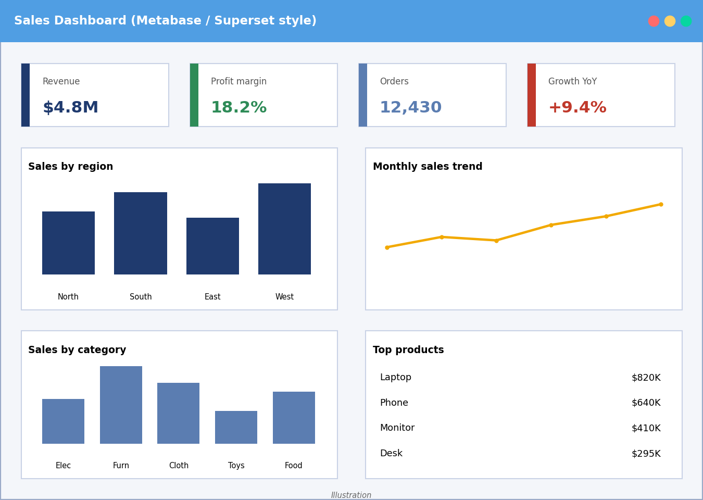
Real-World Example
Reporting and Visualization
Reports: scheduled, ad hoc and drill-through
Visuals: bar, line, pie, map, heat map
Dashboards show KPIs such as revenue, margin and growth
Example: a retail dashboard of sales by region with drill-down
Illustration: dashboard in the style of Metabase / Superset

Slide 42
Tool / Demo
Open-Source BI Tools
Tool | Strength
Metabase | Easy dashboards and questions without SQL
Apache Superset | Rich charts, SQL Lab, scalable
Pentaho / Jaspersoft | Enterprise-style reporting
BIRT | Embedded and printable reports
KNIME | Visual analytics workflows

Slide 43
Conclusion
Summary and Future Scope
Summary
Optimizers pick efficient plans for large warehouse queries
BI tools deliver reports and visuals to decision makers
Future Scope
AI-driven query optimization
Self-service and augmented analytics

Slide 44
Topic 7
OLAP Application using KNIME

Slide 45
Introduction
OLAP Application using KNIME
KNIME: open-source, visual platform for data analytics (low-code)
Build workflows by connecting nodes instead of writing code
Importance: easy to prototype OLAP-style analysis and reports
Reads CSV, Excel and databases; produces charts and reports

Slide 46
Core Concepts
OLAP Application using KNIME
Node: a single task (read, filter, group)
Connection: links one node's output port to the next input
Workflow: a chain of connected nodes
Status lights: red, yellow, green
File / Excel Reader
Row Filter
GroupBy / Pivoting
Bar Chart / Table View

Slide 47
Process / Architecture
Performing OLAP Operations in KNIME
1
Roll-up
GroupBy node with a higher-level column (e.g., Year)
2
Drill-down
GroupBy on a finer level (e.g., Month)
3
Slice
Row Filter: one dimension value (Region = East)
4
Dice
Row Filter / Rule Engine on several conditions
5
Pivot
Pivoting node to rotate rows and columns

Slide 48
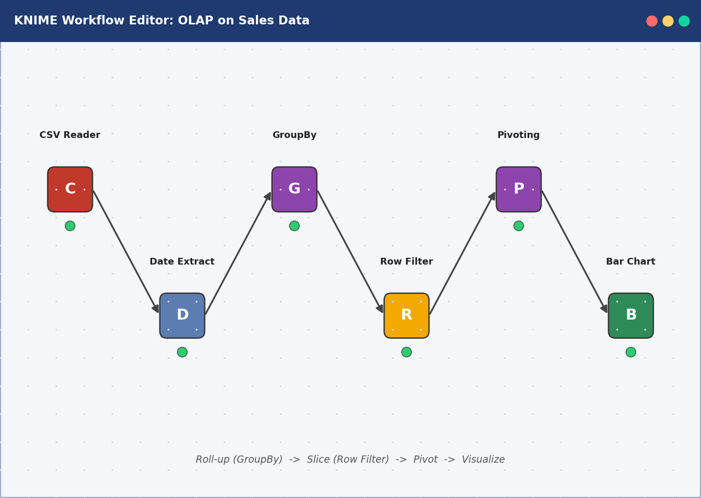
Real-World Example
Sample Application: Sales Analysis
Data: Superstore-style sales CSV (Date, Product, Region, Sales)
Read file, then parse dates and extract Year/Quarter
Roll-up: total sales by Region and Year
Slice East region, pivot Category by Year, plot a bar chart
Illustration: KNIME workflow for OLAP operations

Slide 49
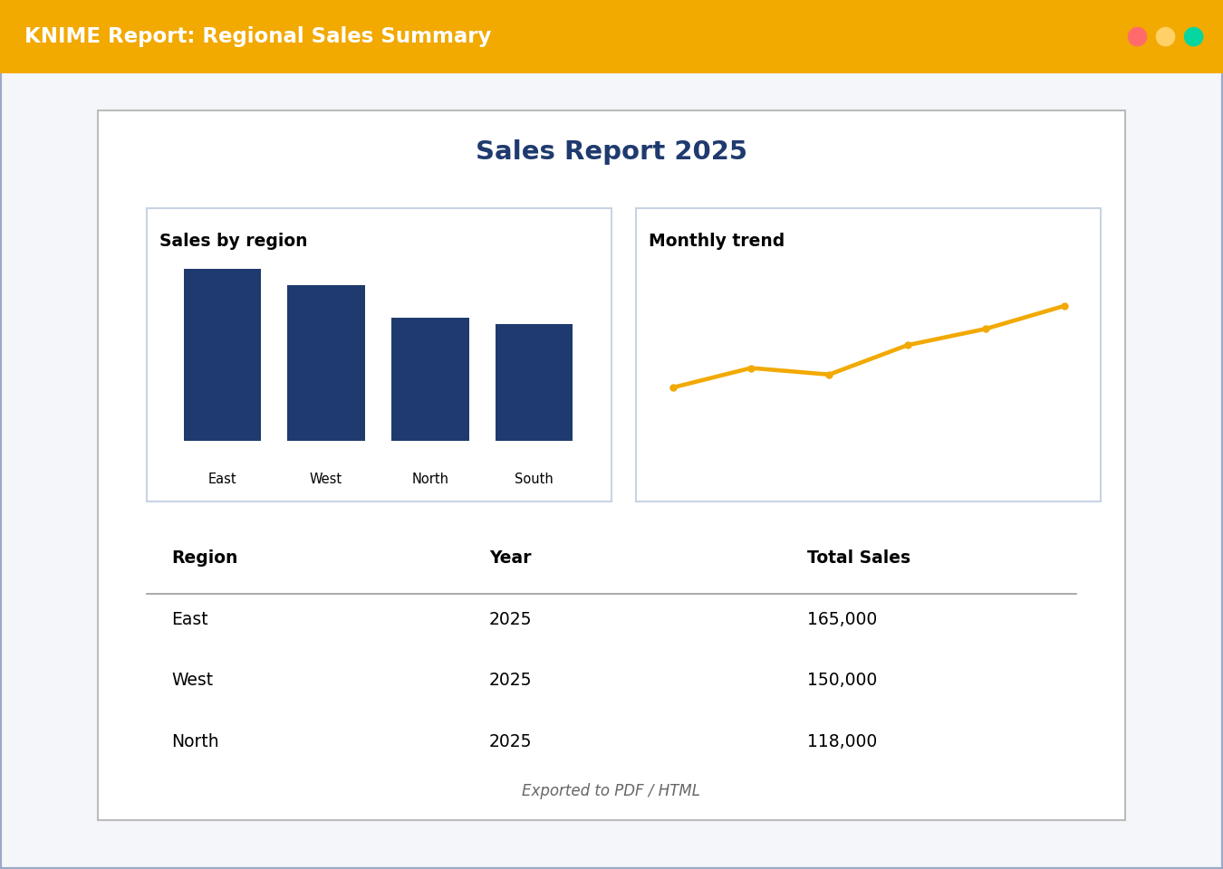
Tool / Demo
Report Generation
Visualization nodes: Bar Chart, Line Plot, Pie Chart
Combine views into dashboards with components
Export results via Excel Writer or CSV Writer
KNIME reporting features can assemble views into PDF/HTML reports
Illustration: report exported from KNIME views

Slide 50
Conclusion
Summary and Future Scope
Summary
KNIME makes OLAP operations visual and repeatable
Nodes + connections = workflow from data to report
Future Scope
Scheduling workflows on KNIME Server / Hub
Adding ML models and AI nodes to reports

